Slide 1
DDA/IVA/ISA/Insert Acronym Here Initial Setup Overview

Slide 2






Typical ISA Setup
Many : 1 Relationship
SmartRep
slide.json
Veeva
keymessage.json

Slide 3
Slide.json
{
"id": 1,
"name": "humira_gastro_content_grid_00",
"description": "Home",
"keymessage": [1],
"template": [],
"template_ajax": [],
"js": [],
"less": []
},
- Unique ID for each entry (just incremented)
- Part of the keymessage id in Salesforce
- What the slide will be called in Veeva
- Which keymessage.json entry to use
- Template files for the slide
- No idea!
- Javascript files for the slide
- Less files for the slide
SmartRep
Keymessage.json
{
"id": 1,
"product": "AbbVie Humira Gastro IVA",
"product_id": "a00O000000VGbVA",
"clm_presentation":
"abbvie_humira_gastro_content_grid_00",
"presentation_version": "01",
"display_order": "0",
"active": true,
"slide_version": "1"
},
- Unique ID for each entry (just incremented)
- Name of the product for the slide
- Product ID in Salesforce, taken from the URL
- Presentation name associated with the slide
- Version of the presentation
- Display order for the slide in the presentation
- Should always be true
- Version of the slide
As far as I know, items in this color are irrelevant!

Slide 4
Presentation.json
{
"id": 1,
"name": "abbvie",
"bodyclass": "",
"slide": [],
"template":[],
"less":[],
"js":[]
}
- Unique ID for each entry (just incremented)
- Part of the keymessage id in Salesforce
- Add a class to the body in all slides
- Order slides should appear in SmartRep
- Template files for the presentation
- Javascript files for the presentation
- Less files for the presentation
SmartRep
The keymessage id in Salesforce is created in SmartRep by combining the Presentation.json name with each Slide.json name, connected with underscores: abbvie_humira_gastro_uc_00.zip

Slide 5
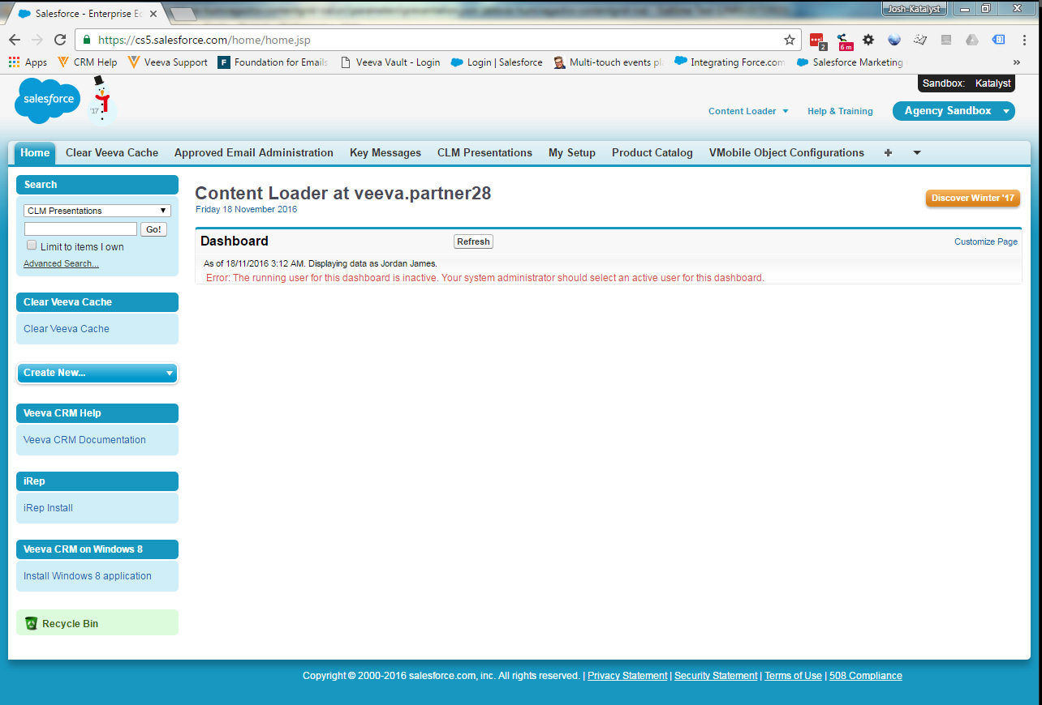
SalesForce - Overview
This is where SmartRep sends our Slides
This is where we need to set up the presentation
And this is where we set up the product for the ISA
If you don’t see these tabs, click here for the full tab list!

Slide 6
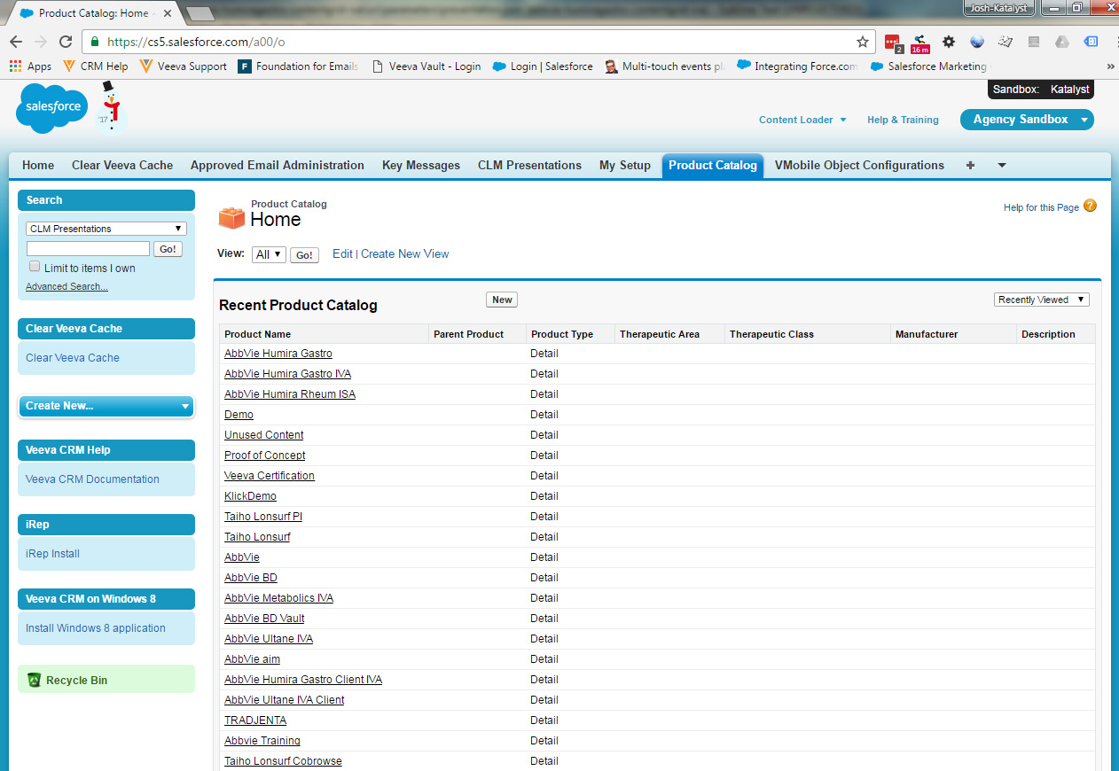
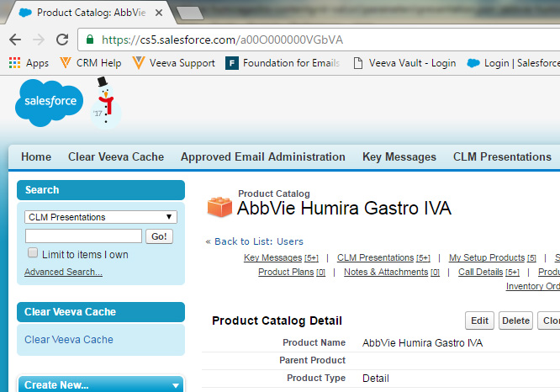
SalesForce – Product ID
To find the product ID, click the product you want to use to open it’s details page.
The ID we need for our keymessage.json is the string at the end of the URL. For AbbVie Humira Gastro IVA, the string is “a00O000000VGbVA”

Slide 7
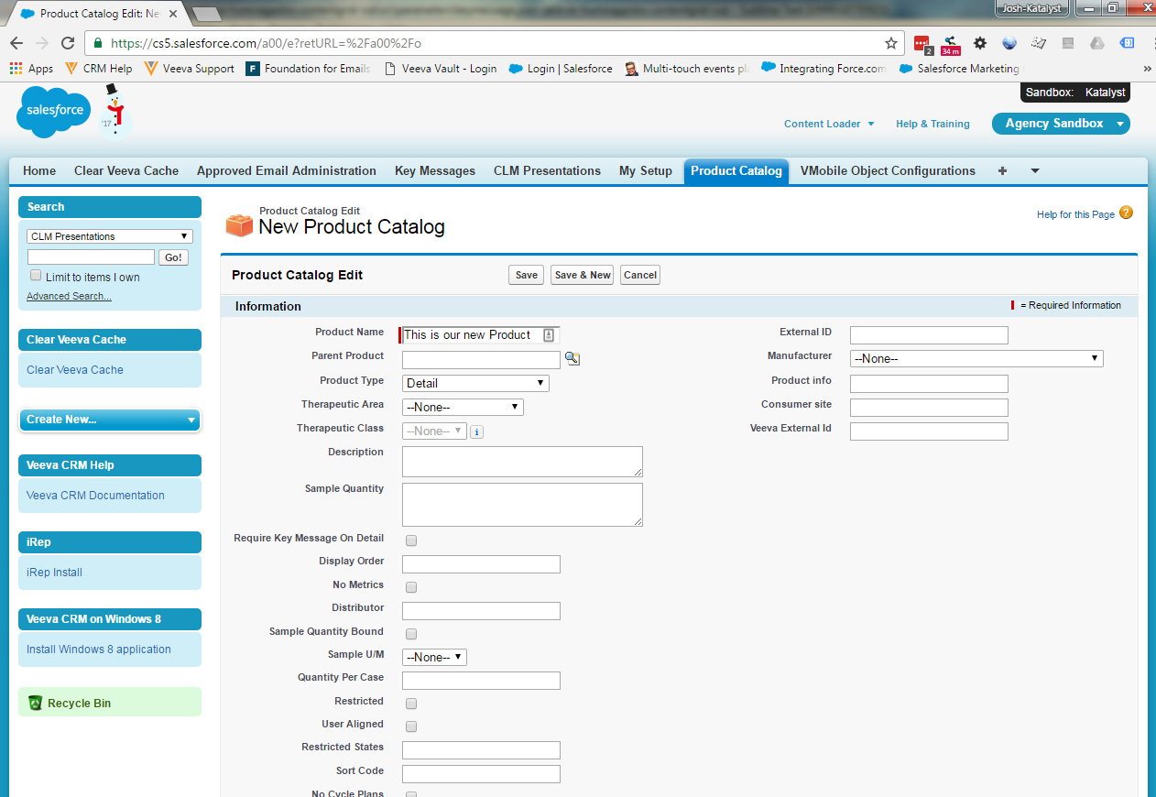
SalesForce – New Product
To create a new Product, press “New” on the product Catalog page. It will take you to the New Product Catalog page.
Enter the name you want to use for the new product
For ISAs, the Product Type should be set to Detail.
Only the 2 fields need to be completed to create a valid product.
When you hit save, it will take you to the product page for your new product, where you can grab the ID from the URL
You will need to get your new product setup with an account for syncing to Veeva. Let the CRM team know which product and which login you are using, and they can create the association for you.

